Slide 1
SAP BTP Extension Suite Training
Day 17
Anubhav Oberoy
www.AnubhavTrainings.com
Follow excellence with sheer passion

Slide 2


DISCLAIMER
The training content and delivery of this presentation is confidential, and cannot be recorded, or copied and distributed to any third party, without the written consent of Anubhav Trainings

Slide 3
Agenda – Day 17
01
Build Workzone
02
Attachments
03
Multi tenancy

Slide 4
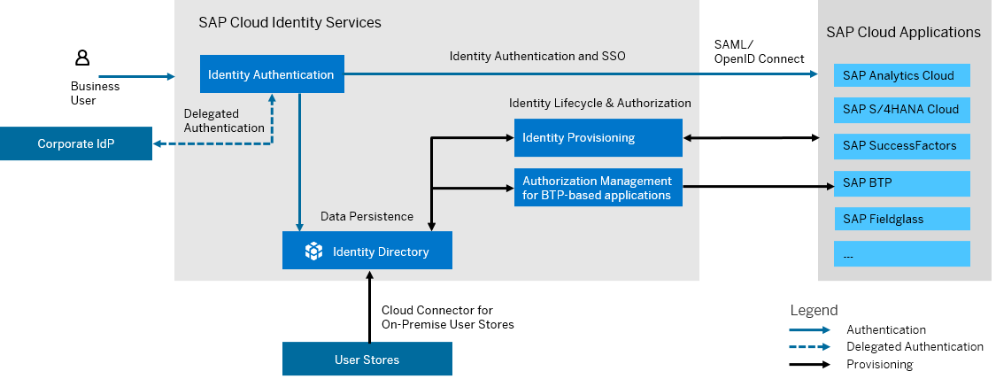
What is SAP Cloud Identity Service?
SAP Cloud Identity Services are a group of services of SAP Business Technology Platform (SAP BTP), which enable you to integrate identity and access management between systems. The goal is to provide a seamless single sign-on experience across systems while ensuring that system and data access are secure. SAP Cloud Identity Services include Identity Authentication, Identity Provisioning, Identity Directory and Authorization Management.

Slide 5
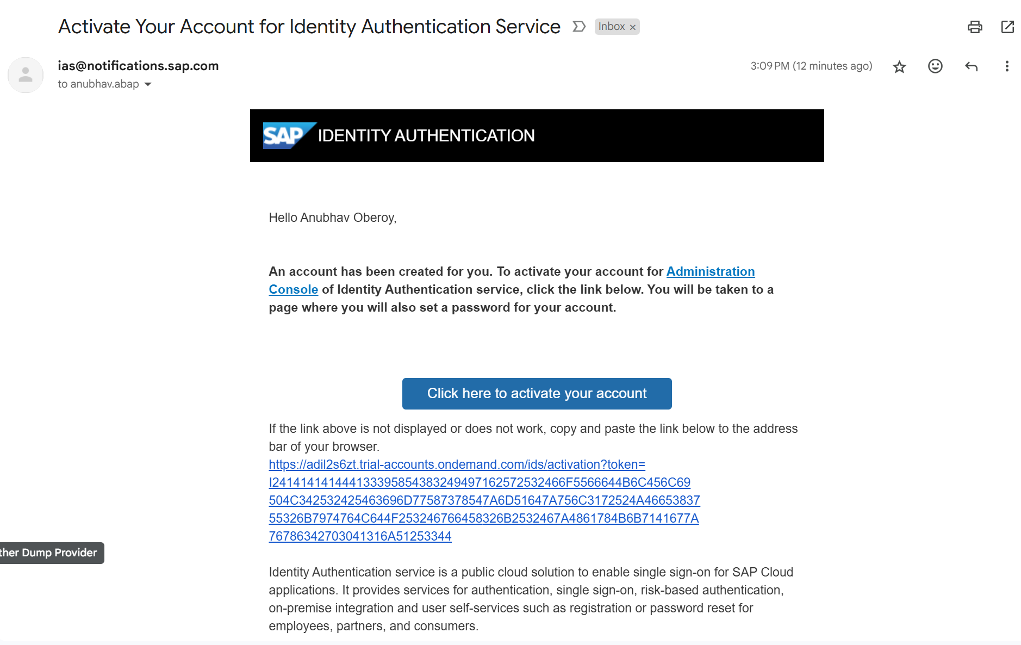
Become Admin for your Identity Service

Slide 6




Persona
BTP Admin (Anubhav)
BTP Developer (Anubhav)
Application Admin (Subbu)
Business users (Raj, Sonia, Rob, Sajeev, Bhagya)
Subscribe to different services
Configure entitlements
Create Subscriptions
Create Roles
Manage Users in company
Manages environment, spaces
Create destinations
Configure Landscape in CTMS
Configure SAP BTP Cloud Identity service and Appoints Subu as Application Admin
Create Trust Relation between Cloud Identity Service and BTP Sub Account
Subscribe to SAP Build Workzone and give access to developer and also to App Admin
Send email to Subu for build workzone
Use BAS tool
Create Fiori on Cloud App
Create CAPM app
Deploy App
Push code to git
Configure Backing service
Testing and deployment
Manage Applications
Configure tiles for Build Workzone
Already created a Fiori on Cloud Application, Will deploy this app to BTP in HTML5 Repository
Admin for Business users
Create Application role
Create Role Collections
Register business users
Reset their passwords
Configure Company SSO with BTP
Grant Role Collections to business users
Give access to Build workzone app to business users
Grant Fiori App Access to business users
Receives email and access SAP Build Work zone
Login to BWZ and configure a site
Fetch the apps deployed by deb to html5-repo
Check slide
They are using actual apps in their respective departments
Create Sales order
Create purchase order
Manage Service contract
….

Slide 7
How to configure Build Workzone
Receives email and access SAP Build Work zone
Login to BWZ and configure a site
Fetch the apps deployed by developer to html5-repo from the channel manager
Go to content explorer>HTML5 Explorer> Import the app for the user in the Content Manager
Import the app to the Content Explorer and the app is now available [ToDo: Next session Anubhav has to show our deployed html5 app instead the mock app]
Create a catalog – Collection of tiles, Add all apps to the catalog and save
Create a group – Providing meaningful grouping of apps for easy navigation e.g. Employee, Manager etc.
Create a role – once granted to our business users they can access the app
Open the site settings, and perform role assignment to the site
----
Registers the business user
[BU] Receives and email and activates his/her SAP account with SAP Custom Idp (Cloud Identity Service)
Grant the business user access to our Role and Launchpad external user role so they can access our apps
Share the link of the business site with the user which when they open, they can consume applications.
[BU] Goes and access the launchpad (site)
https://help.sap.com/docs/cloud-identity-services/cloud-identity-services/configure-idp-initiated-sso
https://help.sap.com/docs/btp/sap-business-technology-platform/developing-with-sap-cloud-application-programming-model

Slide 8
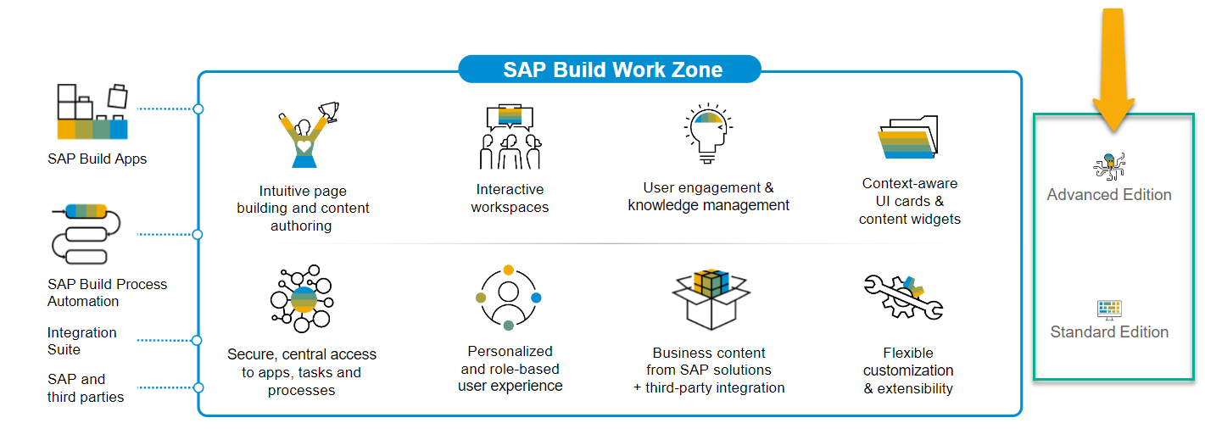
SAP Build Work Zone?
SAP Build Work Zone, is a powerful SAP Business Technology Platform service that consists of several components to integrate cloud and on-premise applications onto a single page including site designing capabilities.
SAP Launchpad Services is now called SAP Build Work Zone, Standard

Slide 9

Hands-on Setting up Build Work Zone

Slide 10
Support for attachments
Often we want to enable upload of documents and store in cloud with our CAP application. SAP already offer a attachment plugin which can be used.
It creates a database table called Attachment for you to store all attachments
When user uploads attachment, the plugin also does virus scan
Supports all kinds of attachments like pdf, images, word, ppt, etc.
Little development effort
https://cap.cloud.sap/docs/plugins/#attachments
Requirement:
Along with PO, we want to enable user to upload multiple attachments. Like user can upload the reference quotation of vendor, additional documents, required approval screenshots of PO etc.
https://www.npmjs.com/package/@cap-js/attachments

Slide 11
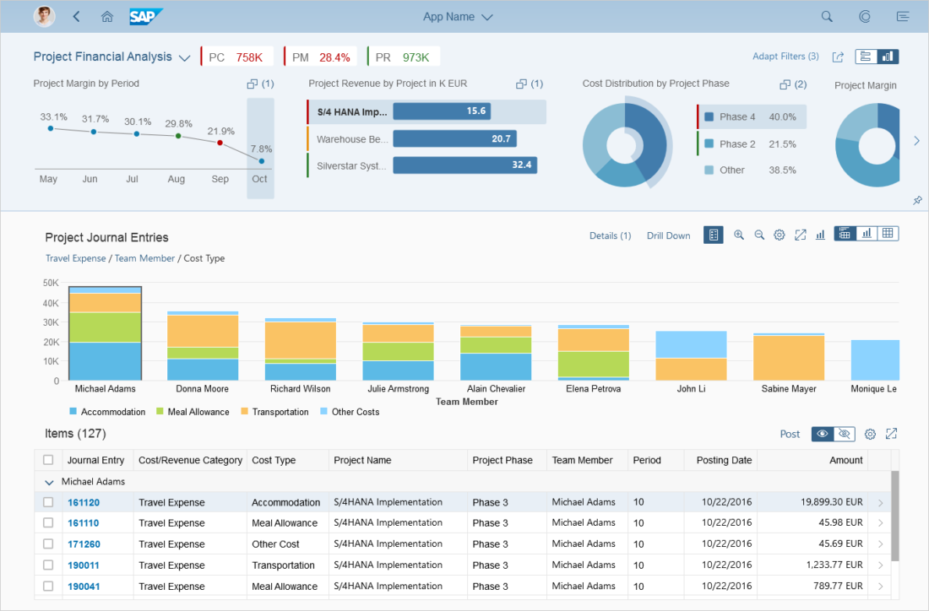










Slide 12













Slide 13
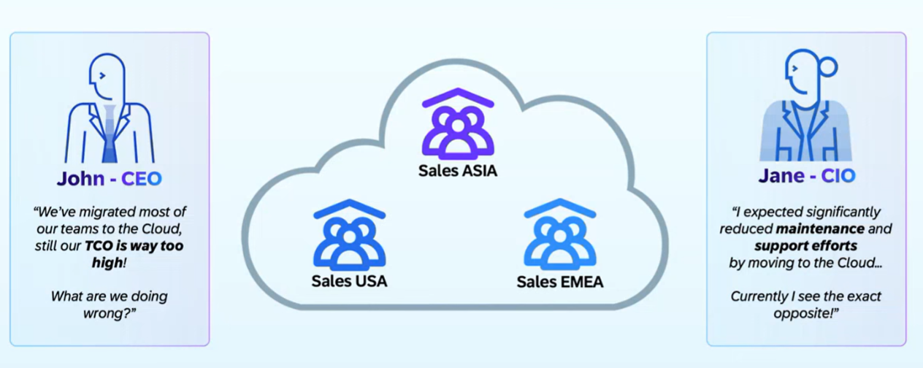
Why Multi-tenant App?

Slide 14
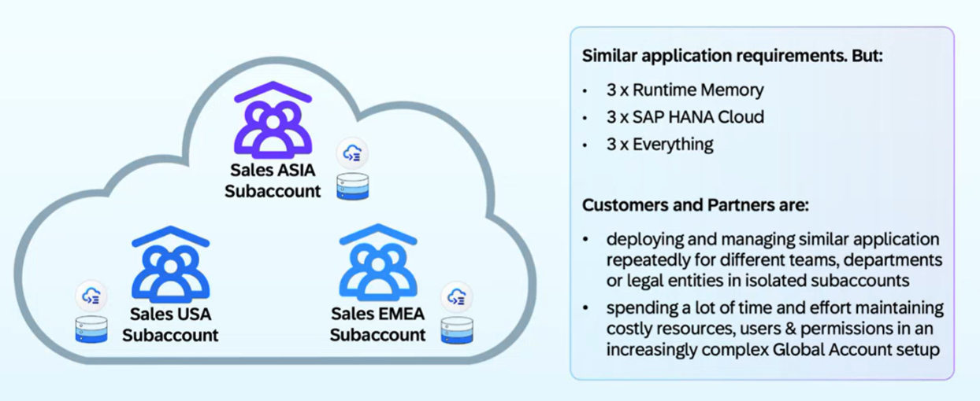
Common Challenges

Slide 15
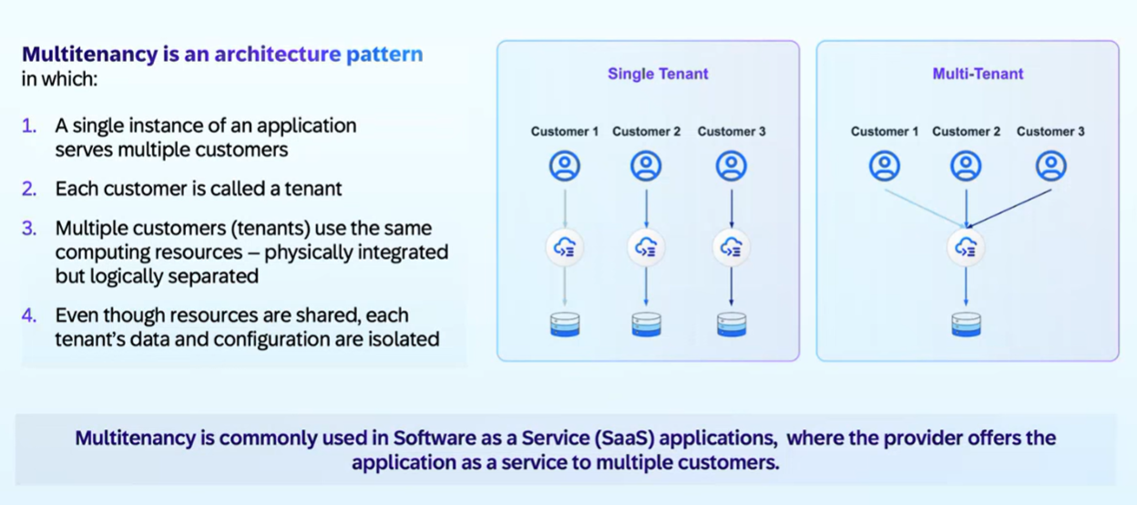
What is Multitenant - SaaS

Slide 16
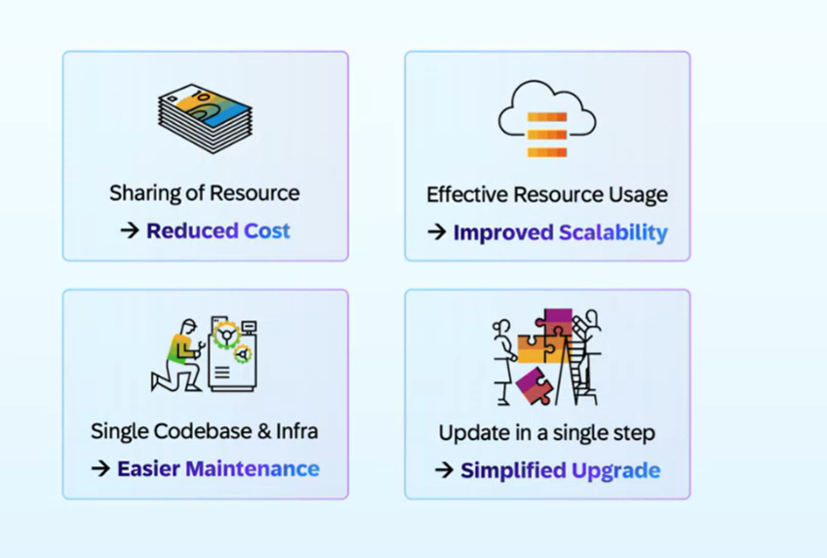
Benefits of Multi tenant App

Slide 17
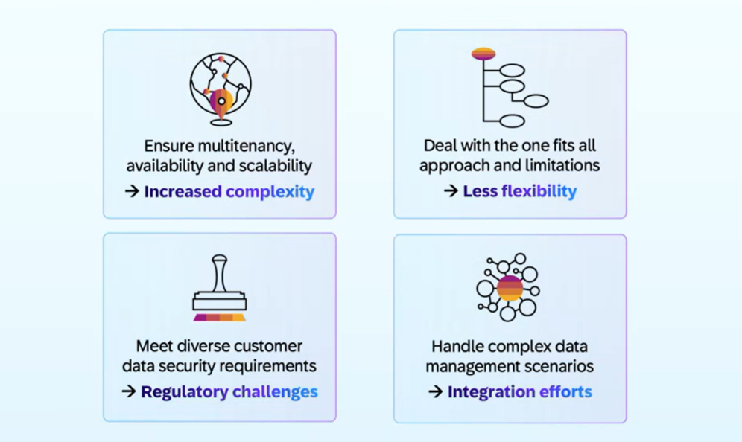
Challenges

Slide 18
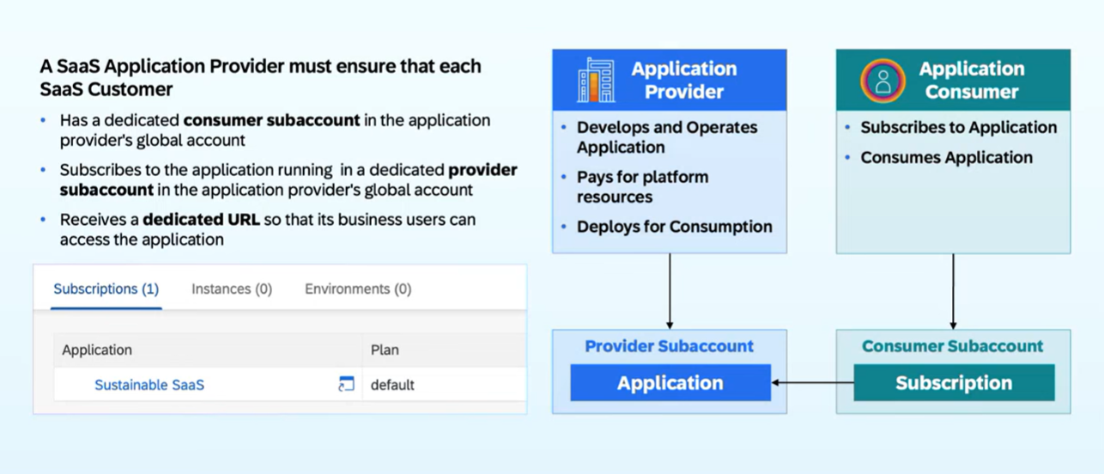
How it works in BTP?

Slide 19
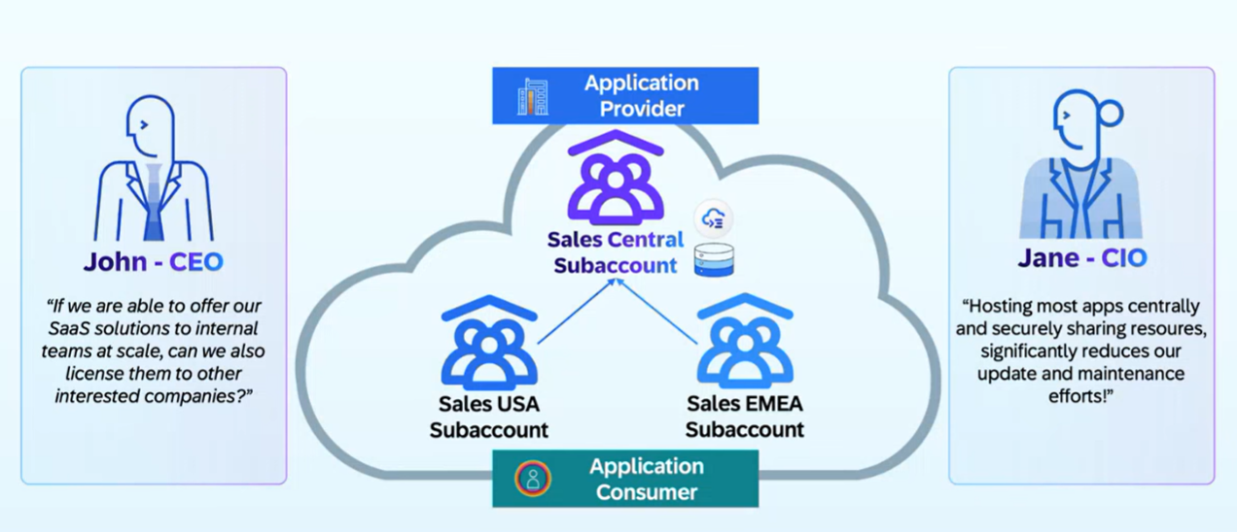
SAP Customer Perspective

Slide 20
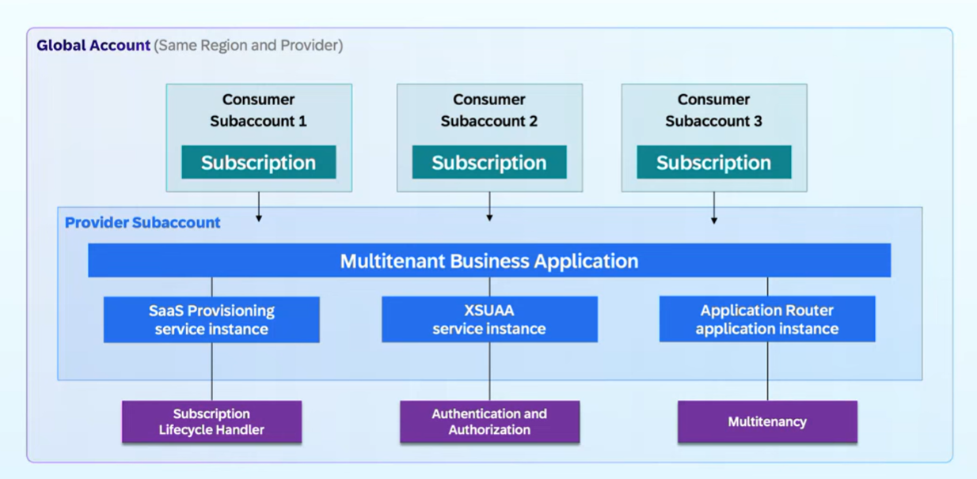
Multi-tenant App on BTP

Slide 21
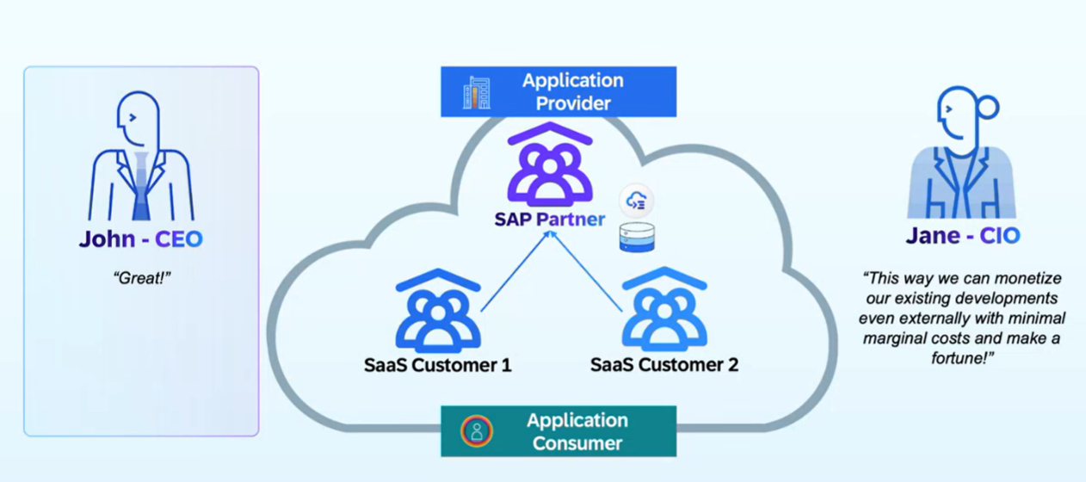
Partner Solutions

Slide 22
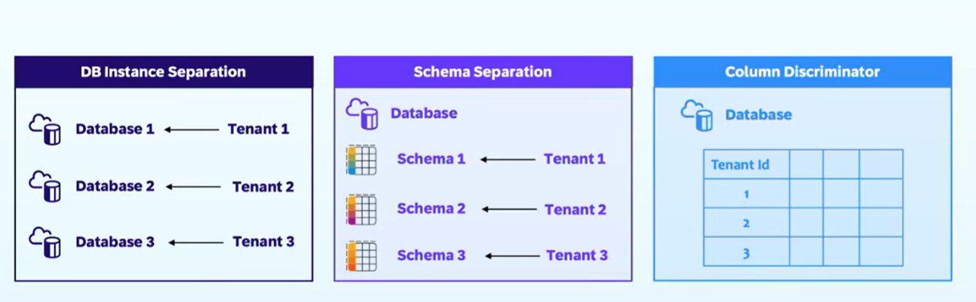
Data Separation for Multi tenant Apps

Slide 23
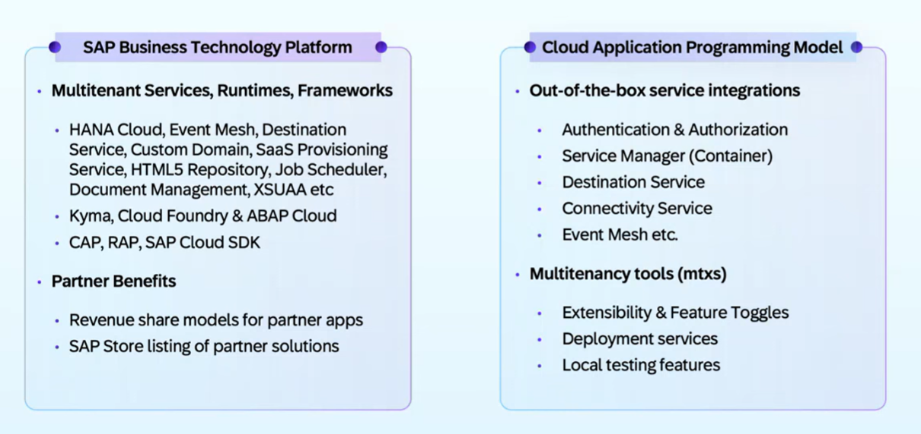
SAP BTP Offerings

Slide 24
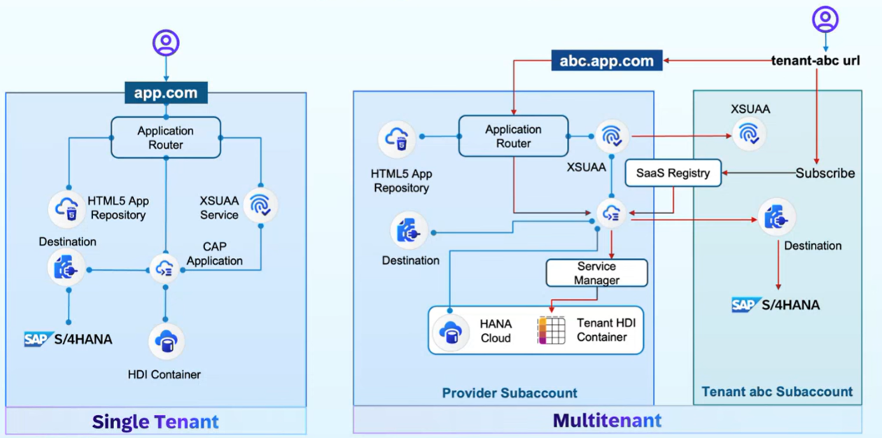
Multi Tenant App – Architecture with CAP

Slide 28

What We Did
Let’s Summarize

Slide 29

www.anubhavtrainings.com
Thank You
End of Day 17

Slide 30


We’re committed to empower you to be
#FutureReady
through powerful training solutions.
We build the workforce of the future.
260+
Corporate Clients
60,000+
Learners Trained
26000+
Learners Placed
FREE WEBINARS
Sign up for free webinars with industry experts every fortnight!
Enroll Now!
Contact us today!
https://anubhavtrainings.com

